Slide 1
Session 26
Swing - 1

Slide 2
Review
The new I/O classes are present in five packages.
The new I/O system is based on two concepts: buffers and channels. A buffer is a container to hold fixed amount of data. A channel represents an open connection to an I/O device like file or socket.
Buffers have four attributes: Capacity, Position, Limit and Mark.
Channel API’s are specified by interfaces. There are two methods in the channel interface: isOpen() and close().
Channel act as a conduits to I/O services

Slide 3
Review Contd…
There are two types of channels: file and socket. There is only one FileChannel class and three socket channel classes: SocketChannel, ServerSocketChannel and DatagramChannel.
File locking facility has been added in JDK 1.4. The locks can be shared or exclusive.
The map() method in the FileChannel class establishes a memory mapping between an open file and a special type of ByteBuffer.
Once an area has been mapped it will remain so until and unless the MppedByteBuffer object is garbage collected.
The transferTo() and transferFrom() enables data to be transferred from one channel to another channel without passing it through an intermediate buffer.

Slide 4
Objectives
Discuss JFC
Describe Swing classes such as
  JComponent
  JFrame
  JPanel
  JApplet
  JRootPane,JScrollPane,JViewPort

Slide 5
Objectives Contd…
Describe GUI Components such as
  Label
  TextComponents
Describe Buttons, CheckBoxes and RadioButtons
Describe Lists and ComboBoxes

Slide 6
Foundation Class
Individuals are constantly on the lookout for simpler means of carrying out a particular activity.
Software platforms provide us with “Foundation Classes” (FC).
FC simplifies the designing process and reduces time taken to code.
For example, creating a menu is simplified by FC.
Microsoft Foundation Classes (MFC) and Java Foundation Classes (JFC) are two popularly used classes.

Slide 7
Java Foundation Classes (JFC)
Programmer
AWT
Applications or
Applets
AWT had restrictions in rendering and event handling.
This led to the development of JFC.
JFC extends the original AWT by adding a set of GUI class libraries.
Provides additional visual component classes.

Slide 8
Swing Components
Swing is a set of classes under JFC.
Provides lightweight visual components and enable creation of an attractive GUI.
Contains replacement components for AWT visual components and also complex components - trees and tables.
While designing a GUI, there is a main window on which visual components are placed.
Swing components are in the javax.swing package
The names of all Swing components start with J.

Slide 9

Swing Components Contd…
Top-level
container
Menu Bar
Visible
Components
Hello World
Content
pane

Slide 10
JFrame
A top-level container or window.
Provides place for other Swing components.
JFrame components is used to create windows in Swing program.
Some of its constructors are:
  JFrame()
  JFrame(String Title)
Components have to be added to the content pane and not directly to the JFrame object
  Example : frame.getContentPane().add(b);

Slide 11
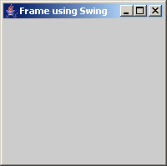
Example
import java.awt.*;
import javax.swing.*;
public class FrameDemo extends JFrame
{
public FrameDemo(String title)
{
super(title);
setVisible(true);
setSize(200,200);
}
public static void main(String args[])
{
FrameDemo objFrameDemo = new FrameDemo("Frame using Swing");
}
}
Output

Slide 12
JPanel
JPanel component is an intermediate container.
Used to group small lightweight components together.
JPanel objects have FlowLayout as their default layout.
JPanel has the following constructors:
  JPanel()
  JPanel(LayoutManager lm)

Slide 13
JApplet
javax.swing.JApplet is slightly different from java.applet.Applet.
While adding a component to a JApplet component, it becomes mandatory to add it to the JApplet’s content pane
  Example : getContentPane().add(component);

Slide 14
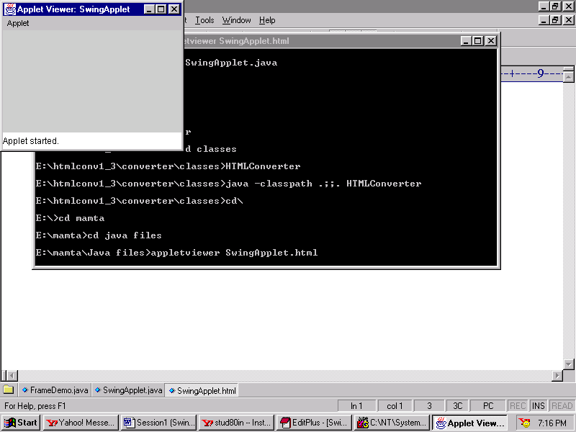
Example
/*
<applet code = SwingApplet width = 150 height =150>
</applet>
*/
import java.awt.*;
import javax.swing.*;
public class SwingApplet extends JApplet
{
public void init()
{
}
}
Output

Slide 15
Content Pane and Applets
Content pane makes Swing applets different from regular applets in the following ways:
  Components are added to the content pane of Swing applets, not directly to the applet.
  The layout manager is set on a Swing applet’s content pane, not directly on the applet.
  Default layout manager for Swing applet’s content pane is BorderLayout whereas for regular applet’s, it is FlowLayout.
  Code for paint() method is put into JApplet object by including paintComponent() method.

Slide 16
Basic GUI Components
A form can be used for collecting information.
While creating GUI’s, a component that can be used to enter data is a text field or text box.
To create elements on a GUI, the steps to be followed are:
  Create the element
  Set its attributes (size, color, font)
  Position it
  Add it to the screen

Slide 17
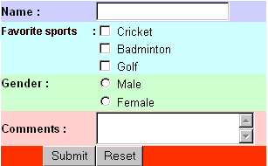
Various components
Label
Text field
Checkbox
Radio button
Text Area
Button

Slide 18
JLabel
Can display text as well as images .
Improves the visual appeal of the GUI screen.
Some of the constructors of JLabel are :
  JLabel (Icon img): Only Icon will be used for label.
  JLabel (String str): Only text will be used for label.
  JLabel (String str, Icon img, int align): Label will have both text and icon. Alignment is specified by the align argument and can be LEFT, RIGHT, CENTER, LEADING or TRAILING. These are constants and are defined in SwingConstant interface.

Slide 19
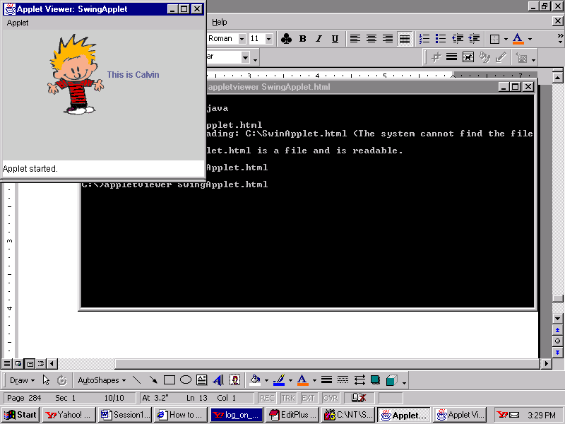
Example
Output
/*
<applet code = LabelDemo width = 200 height =200>
</applet>
*/
import java.awt.*;
import javax.swing.*;
public class LabelDemo extends JApplet
{
public void init()
{
getContentPane().setLayout(new FlowLayout());
ImageIcon icon = new ImageIcon("Calv.gif");
JLabel calvLabel = new JLabel("This is Calvin", icon, SwingConstants.LEFT);
getContentPane().add(calvLabel);
}
}

Slide 20
JTextComponent
JTextComponent is the root class of all Swing text components.
JTextField
JTextArea
JTextComponent
JEditorPane
JTextPane
JPasswordField

Slide 21
JTextComponent Contd…
JTextField component allows us to edit a single line of text.
The constructors of JTextField class are:
  JTextField()
  JTextField(int columns)
  JTextField(String text)
  JTextField(String text, int columns)
The string to be displayed is specified in the text field and maximum length of the column is specified in the columns field.

Slide 22

TextComponents Contd…
import java.awt.*;
import javax.swing.*;
public class TextFieldDemo extends JFrame
{
public TextFieldDemo()
{
super("Sample JTextField");
Container con = getContentPane();
con.setLayout(new FlowLayout());
JLabel lbl = new JLabel("Sample TextField");
con.add(lbl);
JTextField txt = new JTextField(20);
con.add(txt);
pack();
setVisible(true);
setDefaultCloseOperation(JFrame.EXIT_ON_CLOSE);
}
public static void main(String args[])
{
new TextFieldDemo();
}
}
Output

Slide 23
JTextArea
JTextArea component is used to accept several lines of text from the user.
It implements the scrollable interface to activate scrollbars.
JTextArea component can be created using any one of the following constructors:
  JTextArea()
  JTextArea(int rows, cols)
  JTextArea(String text)
  JTextArea(String text, int rows, int cols)

Slide 24
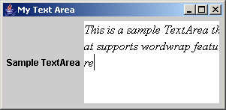
Example
import java.awt.*;
import javax.swing.*;
public class TextAreaAppln extends JFrame
{
public TextAreaAppln(String str)
{
super(str);
Container con = getContentPane();
con.setLayout(new FlowLayout());
JLabel lbl = new JLabel("Sample TextArea");
con.add(lbl);
JTextArea txt = new JTextArea(5,15);
txt.setFont(new Font("Serif", Font.ITALIC, 16));
txt.setLineWrap(true);
con.add(txt);
pack();
setVisible(true);
setDefaultCloseOperation(JFrame.EXIT_ON_CLOSE);
}
public static void main(String args[])
{
new TextAreaAppln("My Text Area");
}
}
Output

Slide 25
JPassword Field
import javax.swing.*;
import java.awt.*;
import java.awt.event.*;
public class PasswordDemo extends JFrame implements ActionListener
{
JPasswordField txtPassword;
public PasswordDemo()
{
txtPassword = new JPasswordField(12);
txtPassword.setEchoChar('*');
// Set the command string that will be used for handling events
// on the password field
txtPassword.setActionCommand("Password");
txtPassword.addActionListener(this);
JLabel lblPassword = new JLabel("Password : ");
lblPassword.setLabelFor(txtPassword);
JPanel pnlLeft = new JPanel(new FlowLayout(FlowLayout.TRAILING));
// Add the Label and TextBox to the Panel
pnlLeft.add(lblPassword);
pnlLeft.add(txtPassword);
JPanel pnlRight = new JPanel(new GridLayout(0,1));
JButton btnOk = new JButton("OK");
JButton btnCancel = new JButton("Cancel");
// Set the command string that will be used for handling events
// on the ok button
btnOk.setActionCommand("Ok");
btnCancel.setActionCommand("Cancel");
btnOk.addActionListener(this);
btnCancel.addActionListener(this);
pnlRight.add(btnOk);
pnlRight.add(btnCancel);
getContentPane().add(pnlLeft, BorderLayout.WEST);
getContentPane().add(pnlRight, BorderLayout.CENTER);
// Ensure that the application terminates when the user clicks on X
// in the title of the window
setDefaultCloseOperation(JFrame.EXIT_ON_CLOSE);
setTitle("Password Field Demo");
pack();
setVisible(true);
}

Slide 26

JPassword Field Contd…
public void actionPerformed(ActionEvent e)
{
String str = e.getActionCommand();
if("Ok".equals(str))
{
char chPassword[] = txtPassword.getPassword();
String strPassword = new String(chPassword);
if(strPassword.trim().equals("pass"))
{
JOptionPane.showMessageDialog(this,"Correct Password");
}
else
{
JOptionPane.showMessageDialog(this,"Incorrect Password","Error
Message" , JOptionPane.ERROR_MESSAGE);
}
txtPassword.selectAll();
txtPassword.requestFocusInWindow();
}
else
{
System.exit(0);
}
}
public static void main(String [] args)
{
PasswordDemo objPasswordDemo = new PasswordDemo();
}
}
Output

Slide 27
JButton
Buttons trap user action.
JButton class descends from javax.swing.AbstractButton class.
JButton object consists of a text label and/or image icon, empty area around the text/icon and border.
A JButton can be created using:
  JButton()
  JButton(Icon icon)
  JButton(String text)
  JButton(String text, Icon icon)
  JButton(Action a)

Slide 28
Example
import java.awt.*;
import java.awt.event.*;
import javax.swing.*;
public class ButtonDemo extends JPanel implements ActionListener
{
JButton btnImage1, btnImage2;
String message = " ";
public ButtonDemo()
{
// Create icons that can be used to display on the buttons
ImageIcon btnIcon1 = new ImageIcon("red-ball.gif");
ImageIcon btnIcon2 = new ImageIcon("cyan-ball.gif");
// Create the buttons
btnImage1 = new JButton("First Button", btnIcon1);
// Assign hot key for the button label
btnImage1.setMnemonic(KeyEvent.VK_F);
btnImage1.setActionCommand("first");
btnImage2 = new JButton("Second button", btnIcon2);
btnImage2.setMnemonic(KeyEvent.VK_S);
btnImage2.setActionCommand("second");
// Register the butttons with the ActionListener interface
btnImage1.addActionListener(this);
btnImage2.addActionListener(this);

Slide 29
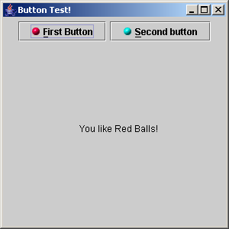
Example Contd…
// Add the two buttons
add(btnImage1);
add(btnImage2);
}
public void actionPerformed(ActionEvent e)
{
// If first button clicked
if (e.getActionCommand().equals("first"))
{
message = "You like Red Balls!";
}
else if (e.getActionCommand().equals("second"))
{
message = "You like Cyan Balls!";
}
repaint();
}
public static void main(String[] args)
{
JFrame objFrame = new JFrame("Button Test!");
objFrame.getContentPane().add(new ButtonDemo());
objFrame.setSize(300,300);
objFrame.setDefaultCloseOperation(JFrame.EXIT_ON_CLOSE);
objFrame.setVisible(true);
}
public void paintComponent(Graphics g)
{
super.paintComponent(g);
g.drawString(message,100,150);
}
}
Output

Slide 30
Buttons using HTML
import java.awt.*;
import javax.swing.*;
import java.awt.event.*;
class HTMLButtonDemo extends JFrame implements ActionListener
{
JButton btnLeft, btnRight;
HTMLButtonDemo()
{
super("HTML Button");
Container con = getContentPane();
con.setLayout(new FlowLayout());
ImageIcon left = new ImageIcon("left.gif");
ImageIcon right = new ImageIcon("right.gif");
// Set the first button using HTML code
// Set color and image for the button
btnLeft = new
JButton("<html><center><b><u>D</u>isable</b><br>"+"<font color=#ffffdd>Left Button </font>",left);
Font objFont = btnLeft.getFont().deriveFont(Font.PLAIN);
btnLeft.setFont(objFont);
btnLeft.setVerticalTextPosition(AbstractButton.CENTER);
btnLeft.setHorizontalTextPosition(AbstractButton.LEADING);
// Assign hot key for the button
btnLeft.setMnemonic(KeyEvent.VK_D);
btnLeft.setActionCommand("disable");
// This button has no HTML coding. It uses text
//and image in the button
btnRight = new JButton("Right Button", right);
btnRight.setFont(objFont);
btnRight.setForeground(new Color(0xffffdd));
btnRight.setVerticalTextPosition(AbstractButton.BOTTOM);
btnRight.setHorizontalTextPosition(AbstractButton.CENTER);
btnRight.setMnemonic(KeyEvent.VK_M);
btnRight.setActionCommand("enable");
btnRight.setEnabled(false);
// Register the buttons with the ActionListener interface
btnLeft.addActionListener(this);
btnRight.addActionListener(this);
// Set tool tips when the pointer is set above the button
btnLeft.setToolTipText("Click to enable the other button");
btnRight.setToolTipText("Click to enable the other button");
con.add(btnLeft);
con.add(btnRight);
pack();
setVisible(true);
setDefaultLookAndFeelDecorated(true);
setDefaultCloseOperation(JFrame.EXIT_ON_CLOSE);

Slide 31

Buttons using HTML Contd…
// Check for the button selected and enable the other button
public void actionPerformed(ActionEvent ae)
{
if("disable".equals(ae.getActionCommand()))
{
btnRight.setEnabled(true);
btnLeft.setEnabled(false);
}
else
{
btnLeft.setEnabled(true);
btnRight.setEnabled(false);
}
}
public static void main(String [] args)
{
new HTMLButtonDemo();
}
}
Output

Slide 32
JCheckbox
Checkbox is used to provide the user with a set of options.
JCheckBox class has the following constructors:
  JCheckBox()
  JCheckBox(Icon icon)
  JCheckBox(Icon icon, boolean selected)
  JCheckBox(String text)
  JCheckBox(String text, boolean selected)
  JCheckBox(String text, Icon icon)
  JCheckBox(String text, Icon icon, boolean selected)
  JCheckBox(Action a)

Slide 33
Example
import java.awt.*;
import java.awt.event.*;
import javax.swing.*;
class Hobby extends JPanel implements ActionListener,ItemListener
{
JCheckBox cboxRead = new JCheckBox("Reading",false);
JCheckBox cboxMusic = new JCheckBox("Music",false);
JCheckBox cboxPaint = new JCheckBox("Painting",false);
JCheckBox cboxMovie = new JCheckBox("Movies",false);
JCheckBox cboxDance = new JCheckBox("Dancing",false);
JLabel lblHobby = new JLabel("What's your hobby?" );
JButton btnExit = new JButton("Exit");
public Hobby( )
{
setLayout(new GridLayout(7,1));
cboxRead.setFont(new Font("Helvetica",Font.BOLD|Font.ITALIC,14));
cboxMusic.setFont(new Font("Helvetica",Font.BOLD|Font.ITALIC,14));
cboxPaint.setFont(new Font("Helvetica",Font.BOLD|Font.ITALIC,14));
cboxMovie.setFont(new Font("Helvetica",Font.BOLD|Font.ITALIC,14));
cboxDance.setFont(new Font("Helvetica",Font.BOLD|Font.ITALIC,14));
cboxRead.addItemListener(this);
cboxMusic.addItemListener(this);
cboxPaint.addItemListener(this);
cboxMovie.addItemListener(this);
cboxDance.addItemListener(this);

Slide 34
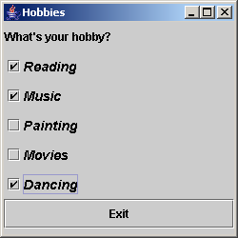
Example Contd…
add(lblHobby);
add(cboxRead);
add(cboxMusic);
add(cboxPaint);
add(cboxMovie);
add(cboxDance);
add(btnExit);
exitbtn.addActionListener(this);
}
public void actionPerformed(ActionEvent e)
{
if(e.getSource().equals(btnExit))
{
System.exit(0);
}
}
public void itemStateChanged(ItemEvent e)
{
// Get the option selected and print on the command window
String selected = ((JCheckBox)e.getSource()).getText();
System.out.println(selected);
}
}
}
class Hobbytest extends JFrame
{
Hobbytest()
{
super("Hobbies");
getContentPane().add(new Hobby());
pack();
setSize(250,250);
setDefaultCloseOperation(JFrame.EXIT_ON_CLOSE);
setVisible(true);
}
public static void main(String args[])
{
new Hobbytest();
}
}
Output

Slide 35
JRadiobutton
A set of radio buttons displays a number of options out of which only one may be selected.
A ButtonGroup is used to create a group in Swing.
JRadioButton object can be created by using:
  JRadioButton()
  JRadioButton(Icon icon)
  JRadioButton(Icon, boolean selected)
  JRadioButton(String text)
  JRadioButton(String text, boolean selected)
  JRadioButton(String text, Icon icon)
  JRadioButton(String text, Icon icon, boolean selected)
  JRadioButton(Action a)

Slide 36
JList
When the options to choose from is large, the user can be presented with a list to choose .
JList component arranges elements one after the other, which can be selected individually or in a group.
JList class can display strings as well as icons.
JList does not provide support for double clicks.
MouseListener can be used to overcome the double click problem.

Slide 37
JList Contd…
public JList() – constructs a JList with an empty model.
public JList (ListModel dataModel) – displays the elements in the specified, non-null list model.
public JList(Object [] listData) – displays the elements of the specified array “listData”.
JList does not support scrolling. To enable scrolling, the following piece of code can be used:
  JScrollPane myScrollPane=new JScrollPane();
  myScrollPane.getViewport().setView(dataList);
  Or
  JScrollPane myScrollPane = new JScrollPane(dataList);

Slide 38
Example
import java.awt.*;
import java.awt.event.*;
import javax.swing.*;
import javax.swing.event.*;
class AllStars extends JFrame implements ListSelectionListener
{
String stars[] = {"Antonio Banderas","Leonardo DiCaprio", "Sandra Bullock","Hugh Grant","Julia Roberts"};
JList lstMovieStars = new JList(stars);
JLabel lblQuestion = new JLabel("Who is your favorite movie star?" );
JTextField txtMovieStar = new JTextField(30);
public AllStars(String str)
{
super(str);
JPanel lstPanel = (JPanel)getContentPane();
lstPanel.setLayout(new BorderLayout());
lstPanel.add(lblQuestion, BorderLayout.PAGE_START);
lstMovieStars.setSelectionMode( ListSelectionModel.SINGLE_SELECTION);
lstMovieStars.setSelectedIndex(0);
lstMovieStars.addListSelectionListener(this);
lstMovieStars.setBackground(Color.lightGray);
lstMovieStars.setForeground(Color.blue);
lstPanel.setBackground(Color.white);

Slide 39
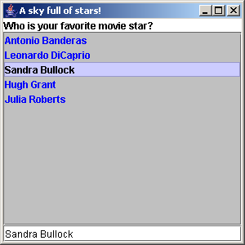
Example Contd…
lstPanel.setForeground(Color.black);
lstPanel.add("Center",new JScrollPane(lstMovieStars));
lstPanel.add(txtMovieStar, BorderLayout.PAGE_END);
pack();
}
public static void main(String args[])
{
AllStars objAllStars = new AllStars ("A sky full of stars!");
objAllStars.setDefaultCloseOperation(JFrame.EXIT_ON_CLOSE);
objAllStars.setSize(300,300);
objAllStars.show();
}
public void valueChanged(ListSelectionEvent e)
{
if (e.getValueIsAdjusting() == false)
{
if (lstMovieStars.getSelectedIndex() != -1)
{
txtMovieStar.setText((String)lstMovieStars.getSelectedValue());
}
}
}
}
Output

Slide 40
JComboBox
Combination of text field and drop-down list.
In Swing, combo box is represented by JComboBox class.
public JComboBox() – this constructor creates a JComboBox with a default data model.
public JComboBox(ComboBoxModel asModel) – a combo box that takes its items from an existing ComboBoxModel.
public JComboBox(Object [] items) – a combo box that contains the elements of the specified array.

Slide 41
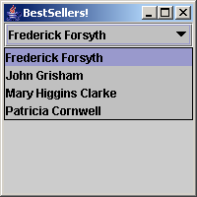
Example
import java.awt.*;
import java.awt.event.*;
import javax.swing.*;
class BestSeller extends JFrame implements ItemListener
{
String names[] = {"Frederick Forsyth", "John Grisham","Mary
Higgins Clarke","Patricia Cornwell"};
JComboBox authors = new JComboBox(names);
public BestSeller(String str)
{
super(str);
JPanel bestPan = (JPanel)getContentPane();
bestPan.setLayout(new BorderLayout());
authors.addItemListener(this);
authors.setBackground(Color.lightGray);
authors.setForeground(Color.black);
bestPan.setForeground(Color.black);
bestPan.add(authors, BorderLayout.PAGE_START);
pack();
}
public static void main(String args[])
{
BestSeller objAuthor = new BestSeller("BestSellers!");
objAuthor.setDefaultCloseOperation(JFrame.EXIT_ON_CLOSE);
objAuthor.setSize(200,200);
objAuthor.show();
}
public void itemStateChanged(ItemEvent e)
{
if (e.getStateChange() == ItemEvent .SELECTED)
{
System.out.println((String)e.getItem());
}
}
}
Output

Slide 42
Editable ComboBox
import java.awt.*;
import java.awt.event.*;
import javax.swing.*;
import javax.swing.event.*;
import javax.swing.border.*;
import java.text.*;
import java.util.*;
class DateDisplay extends JPanel implements ActionListener
{
JLabel result;
String curpat;
DateDisplay ()
{
// Set the layout of the panel as BoxLayout
setLayout(new BoxLayout(this, BoxLayout.PAGE_AXIS));
// Declare a string array and store the various patterns in it.
// Set the current pattern to the first element in the array
String []patterns ={"dd MMMMM yyyy", "dd.MM.yy","MM/dd/yy", "yyyy.MM.dd G 'at' hh:mm:ss z","yyyy.MMMMM.dd GGG hh.mm aaa"};
curpat = patterns[0];
// Create a combo box and initialize it with the String array that contains the pattern list
JLabel patlab = new JLabel ("Enter the pattern or select from list : ");

Slide 43
Editable ComboBox Contd…
JComboBox patlist = new JComboBox(patterns);
patlist.setEditable(true);
// Make the combo box editable
patlist.addActionListener(this);
JLabel reslabel = new JLabel("Current Date / Time is :", JLabel.LEADING);
result = new JLabel(" ");
result.setForeground(Color.red);
// Add the label and the combo box to a panel
JPanel patPanel = new JPanel();
patPanel.setLayout(new
BoxLayout(patPanel,BoxLayout.PAGE_AXIS));
patPanel.add(patlab);
patlist.setAlignmentX(Component.LEFT_ALIGNMENT);
patPanel.add(patlist);
// Add the label where the result will be displayed in the appropriate format
JPanel resPanel = new JPanel(new GridLayout(0,1));
resPanel.add(reslabel);
resPanel.add(result);
//Setting the alignment to the left
patPanel.setAlignmentX(Component.LEFT_ALIGNMENT);
resPanel.setAlignmentX(Component.LEFT_ALIGNMENT);
add(patPanel);
add(Box.createRigidArea(new Dimension(0,10)));
add(resPanel);
reformat();
}

Slide 44
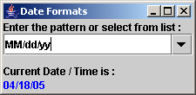
Editable ComboBox Contd…
// Check the currently selected item
public void actionPerformed(ActionEvent e)
{
JComboBox cb = (JComboBox)e.getSource();
String sel = (String)cb.getSelectedItem();
curpat = sel;
reformat();
}
// Get the current date and display it.
// Set the date object to the appropriate format before displaying it.
public void reformat()
{
Date today = new Date();
SimpleDateFormat dateformat = new SimpleDateFormat(curpat);
try
{
String dateString = dateformat.format(today);
result.setForeground(Color.blue);
result.setText(dateString);
}
catch(IllegalArgumentException e)
{
result.setForeground(Color.red);
result.setText("Error " + e.getMessage());
}
}
public static void main ( String [] args)
{
JFrame frame = new JFrame("Date Formats");
frame.setDefaultCloseOperation(JFrame.EXIT_ON_CLOSE);
JComponent objDate = new DateDisplay();
frame.setContentPane(objDate);
frame.pack();
frame.setVisible(true);
}
}
Output

Slide 45
Summary
The Java Foundation Classes (JFC) are developed as an extension to Abstract Windows Toolkit (AWT), to overcome the shortcomings of AWT.
Swing is a set of classes under the JFC that provide lightweight visual components and enable creation of an attractive GUI.
Swing Applets provide support for assistive technologies and a RootPane (and thus support for adding menubar).
With Swing, most of the components can display text as well as images.

